Slide 1
Testing NodeJS (with Mocha, Should, Sinon, & JSCoverage)
Melbourne NodeJS Meetup Group
Wednesday, 28 August 2013
Michael Lilley
michael.lilley@gmail.com
Accompanying Sample Repository - https://github.com/mlilley/testing_nodejs_with_mocha.git

Slide 2
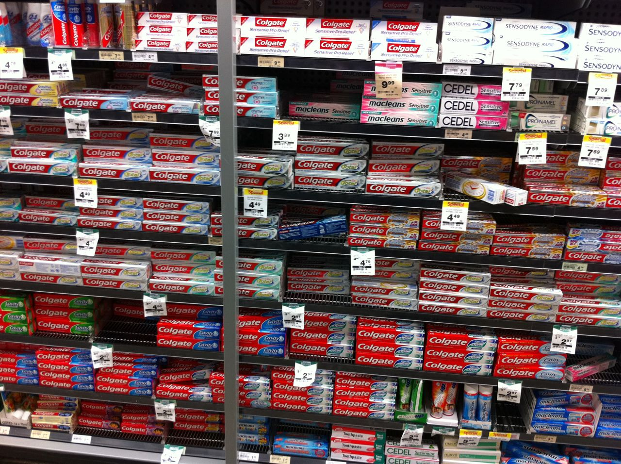
Which Framework?

Slide 3
Why Mocha?
Popular
Decent high level features
Highly configurable to suit many tastes
Been around for almost 2 years
Can run in the browser also

Slide 4
Setting Up
Install mocha module $ npm install mocha
Choose and install your assertion library (we’ll use should) $ npm install should
Create a directory for your tests $ mkdir test

Slide 5
Setting Up
Create your Makefile Remember the tabs!
REPORTER = dot
test:
@NODE_ENV=test ./node_modules/.bin/mocha
--reporter $(REPORTER) \
test-w:
@NODE_ENV=test ./node_modules/.bin/mocha \
--reporter $(REPORTER) \
--watch
.PHONY: test test-w

Slide 6
Setting Up
Configure package.json
{
...
"scripts": {
"test": "make test"
}
...
}

Slide 7
Code To Be Tested
sync_adder.js
var Adder = exports.Adder = function() {};
Adder.prototype.add = function(a, b) {
return a + b;
};
async_adder.js
var Adder = exports.Adder = function() {};
Adder.prototype.add = function(a, b, callback) {
setTimeout(function() {
callback(a + b);
}, 100);
};

Slide 8
Tests - Synchronous
test/sync_adder.js
var should = require('should');
var Adder = require('../sync_adder').Adder;
describe('Synchronous Adder', function() {
describe('add()', function() {
it('should return 3 when adding 1 and 2', function() {
var adder = new Adder();
adder.add(1, 2).should.equal(3);
});
});
});
NB: or use mocha option ‘--require’ to automatically require common deps (ie: Should)

Slide 9
Tests - Asynchronous
test/async_adder.js
var should = require('should');
var Adder = require('../async_adder').Adder;
describe('Asynchronous Adder', function() {
describe('add()', function() {
it('should callback with 3 when adding 1 and 2', function(done) {
var adder = new Adder();
adder.add(1, 2, function(result) {
result.should.equal(3);
done();
});
});
});
});
If done() not called, test fails
Default timeout is 2,000 ms
Adjust with this.timeout(x)

Slide 10
Hooks
before(fn), after(fn), beforeEach(fn), afterEach(fn)
Use within describe() at any nesting level
Use outside describe() for global scope
after/afterEach run on test fail too (unless --bail)

Slide 11
Should DSL
x.should.be.ok
x.should.be.true
x.should.be.false
x.should.be.empty
x.should.be.within(y,z)
x.should.be.a(y)
x.should.be[.an].instanceOf(y)
x.should.be.above(n)
x.should.be.below(n)
x.should.eql(y)
x.should.equal(y)
x.should.match(/y/)
x.should.have.length(y)
x.should.have.property(prop[, val])
x.should.have.ownProperty(prop[, val])
x.should.have.status(code)
x.should.have.header(field[, val])
x.should.include(y)
x.should.throw([string|/regexp/])
// truthiness
// === true
// === false
// length == 0
// range
// typeof
// instanceOf
// > val
// < val
// ==
// ===
// regexp match
// .length == y
// prop exists
// prop exists (immediate)
// .statusCode == y
// .header with field & val
// x.indexOf(y) != -1
// thrown exception
Negation:
x.should.not.be.ok
Chaining:
x.should.be.a(‘string’).and.have.length(5)
Implementation:
should added to Object as property
Therefore x must not be null or undefined
Use should.exist(x) to test first where needed.

Slide 12
Running Tests
Run your tests $ make test or $ npm test or $ ./node_modules/.bin/mocha <options> <path|files>
Run your tests automatically when files change $ make test-w
Run multiple test suites / partial suite / specific tests
Specify desired file or directory on cmd line
Use “tagging” and --grep feature
Tag test names with some unique string (ie “@slow” or “#API” or “APP”)
Pass cmd line option --grep <pattern>
Run Mocha programatically for more control

Slide 13
Mocha Configurability
Change assertion library (require(…))
Should, expect.js, Chai, Expectations, better-assert, Node’s assert lib, etc
Change interface (--ui flag)
for BDD style: describe, it, before, after, beforeEach, afterEach.
for TDD style: suite, test, setup, teardown.
others
Change output Reporter (--reporter flag)
For different styles of terminal output
For output of docs (html, xml, documentation, …)
For feeding into other programs (test coverage, …)
… and more …

Slide 14
Sinon
Sinon
APIs for spies, stubs, mocks, and utils
Framework agnostic
To use:
$ npm install sinon
var sinon = require(‘sinon’);
Don’t include via --require because need access to exports

Slide 15
Test Coverage
Install node-jscoverage binary $ git clone https://github.com/visionmedia/node-jscoverage.git $ ./configure && make && make install
Adjust Makefile to:
invoke jscoverage on source to produce instrumented version
run mocha on instrumented source with html-cov reporter to ourput coverage report.
...
test-cov: lib-cov
@MYPROJ_COVERAGE=1 $(MAKE) test REPORTER=html-cov > coverage.html
lib-cov:
@jscoverage lib lib-cov
...

Slide 16
Test Coverage
Adjust project structure (see example repo)
index.js conditionally requires normal or instrumented source based on env var set in makefile
module.exports = process.env.MYPROJ_COVERAGE
? require('./lib-cov/myproj')
: require('./lib/myproj')
Run it $ make test-cov

Slide 17
For more…
Mocha - http://visionmedia.github.io/mocha/
Mocha Wiki - https://github.com/visionmedia/mocha/wiki
Should - https://github.com/visionmedia/should.js/
Sinon - http://sinonjs.org/
Node-JSCoverage - https://github.com/visionmedia/node-jscoverage

